Slide 1

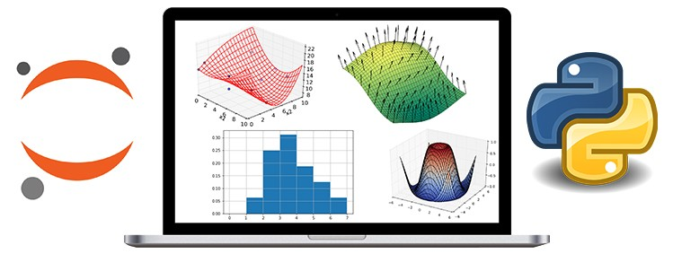
Data Science Certificate Program
Data Visualization with Matplotlib
Mehmet Ali Ergün, Ph.D.

Slide 2
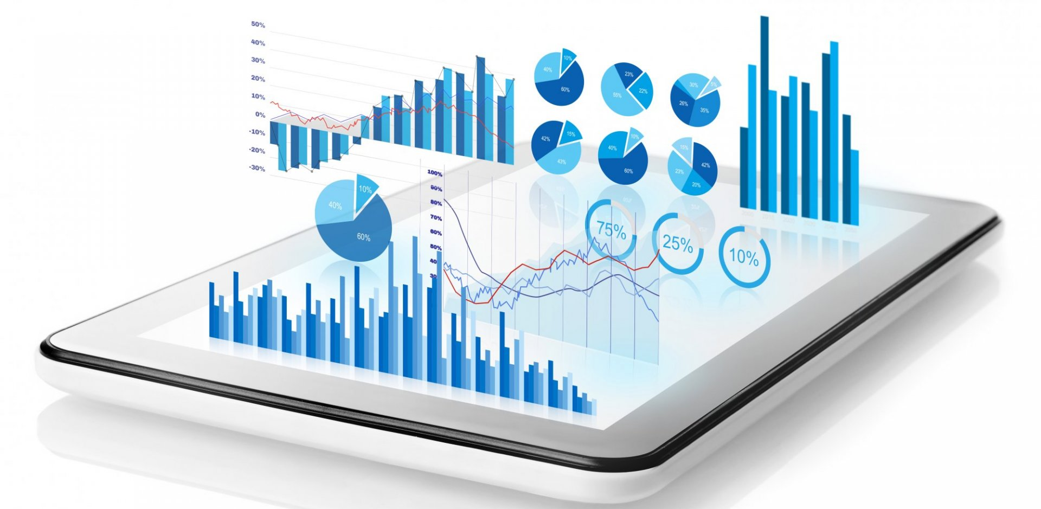
Data Visualization
Data visualization is simply the process of representing the data graphically.
We produce images, plots, infographics and so on to communicate the trends and the relationships within the data.
When used in exploratory data analysis, it also helps data scientists to get a better understanding of the data
Usually considered a form of both art and science
A popular quote:
“A picture is worth a thousand words”

Slide 3
Context is Important
Exploratory vs Explanatory Analysis
In exploratory analysis, we may produce hundreds of graphs/figures to understand the data
But when it comes to present it to the others only choose a few that conveys our message
Don’t be tempted to present every single plot your exploratory analysis produces
Less is more when it comes to conveying your message

Slide 4

Best Practices
When you create visuals to present your data:
Less is more effective
Less is more attractive
Less is more impactive

Slide 5
Level of Detail
Less is good but how much is enough? How to decide?
Level of detail you should include also depends on the mode of the presentation
If you are live-presenting to an audience, you may not need a lot of details because you have more control on your message
If you are preparing a report/written document, you may need to include more details.

Slide 6
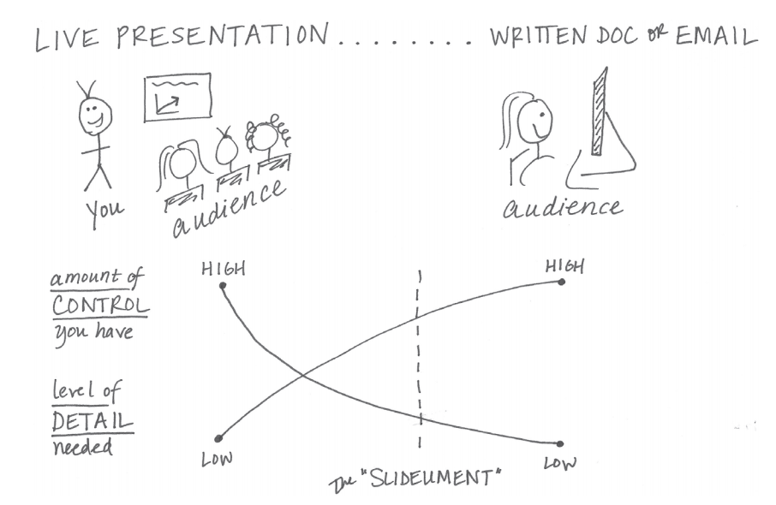
Level of Detail
Source: Storytelling with data by Cole Nussbaumer Knaflic
Recommended reading ↑

Slide 7

Choosing the Right Graph
When visualizing data, our aim, more often than not, fall into one (or two) of the four categories listed below:
Make comparisons
Show the composition of a whole
Show relationships
Visualize the distribution of the data

Slide 8
Choosing the Right Graph
Other factors that may affect your choice in a graph:
Is your data changing over time or static?
If changes over time, what is the time horizon?
How many variables you want to compare / present
When we answer these questions, we narrow down our search

Slide 9
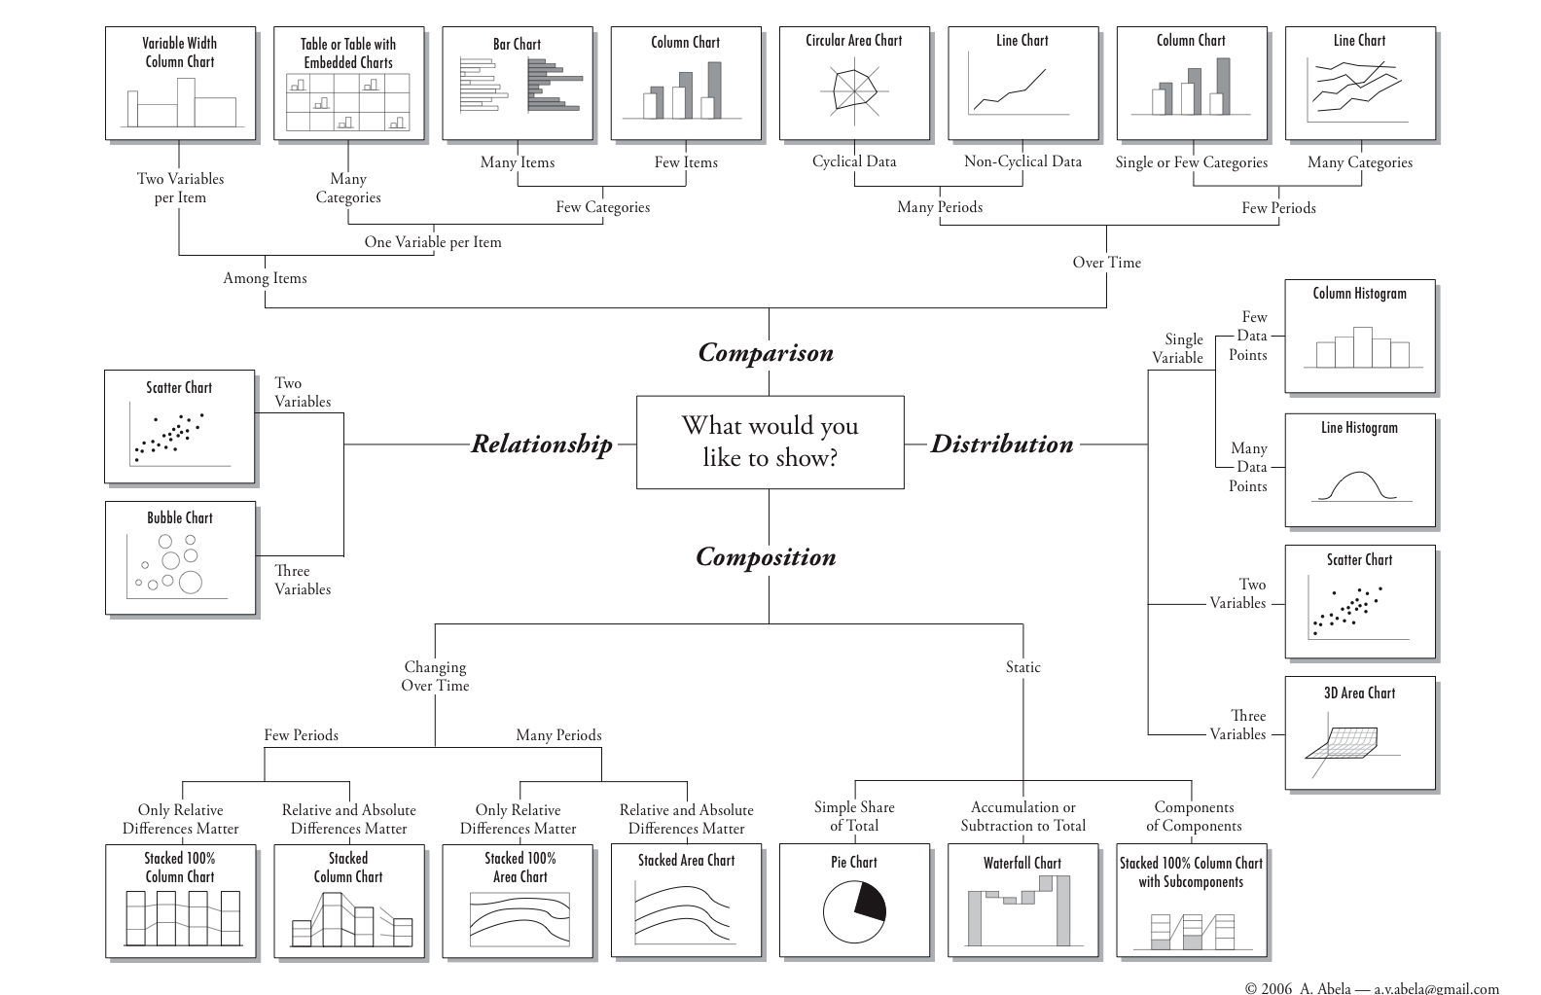
Choosing the Right Graph

Slide 10
Choosing the Right Graph: Pitfalls
Using a pie or donut chart
When visualizing a composition, try to avoid pie charts. Can be used when graphing the share of a single element in a whole
Use Column or Bar charts instead: Humans can compare linear elements easier than arcs and areas.
Avoid 3D: Use it when you really need 3 dimensions (i.e. you have 3 variables to plot)

Slide 11
Choosing the Right Graph: Pitfalls
Example of a less than stellar visual:
A pie chart
Use of 3D
Unnecessary background pattern
Too much color

Slide 12

Choosing the Right Graph: Pitfalls
Example of a less than stellar visual:

Slide 13
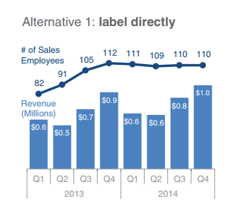
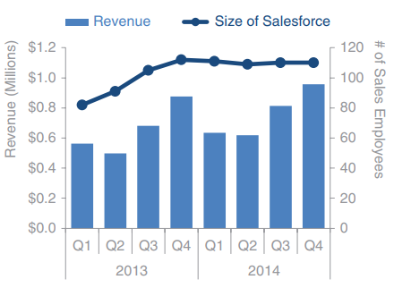
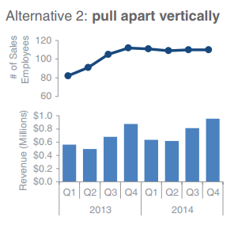
Choosing the Right Graph: Pitfalls
Using a second y-axis:
Source: Storytelling with data by Cole Nussbaumer Knaflic

Slide 14
Additional Material: IBCS
The International Business Communication Standards are practical proposals for the design of reports, presentations, dashboards and the diagrams and tables contained therein.
This involves the conception of the content, the visual perception and the application of a semantic notation. The further development of the IBCS Standards is an ongoing process.
IBCS are managed by the not-for-profit IBCS Association

Slide 15
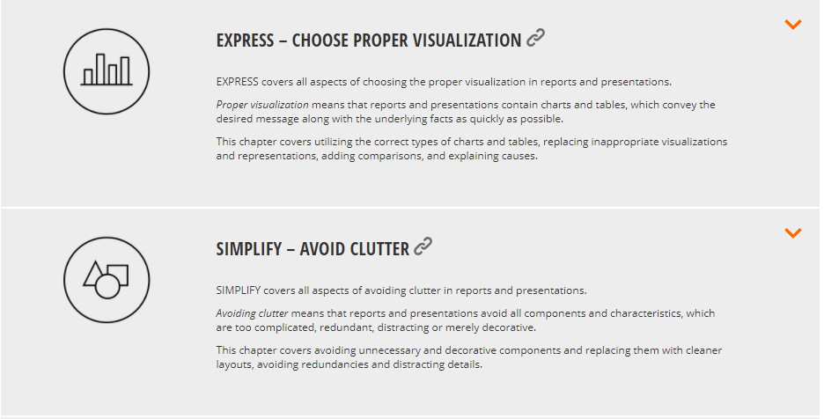
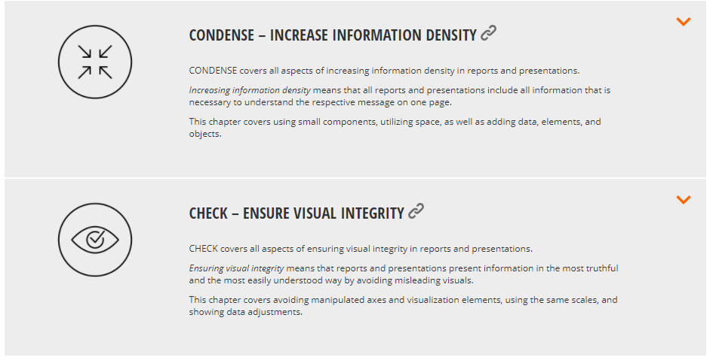
IBCS: Perceptual Rules
Link: https://www.ibcs.com/standards/

Slide 16

Matplotlib Library
Matplotlib is an open-source library that is used to create a variety of plots
It is the go-to library for data-visualization in Python
It gives user a lot of control on how the figure looks
Originally developed by John D. Hunter to emulate a Matlab-like plotting environment for Python

Slide 17
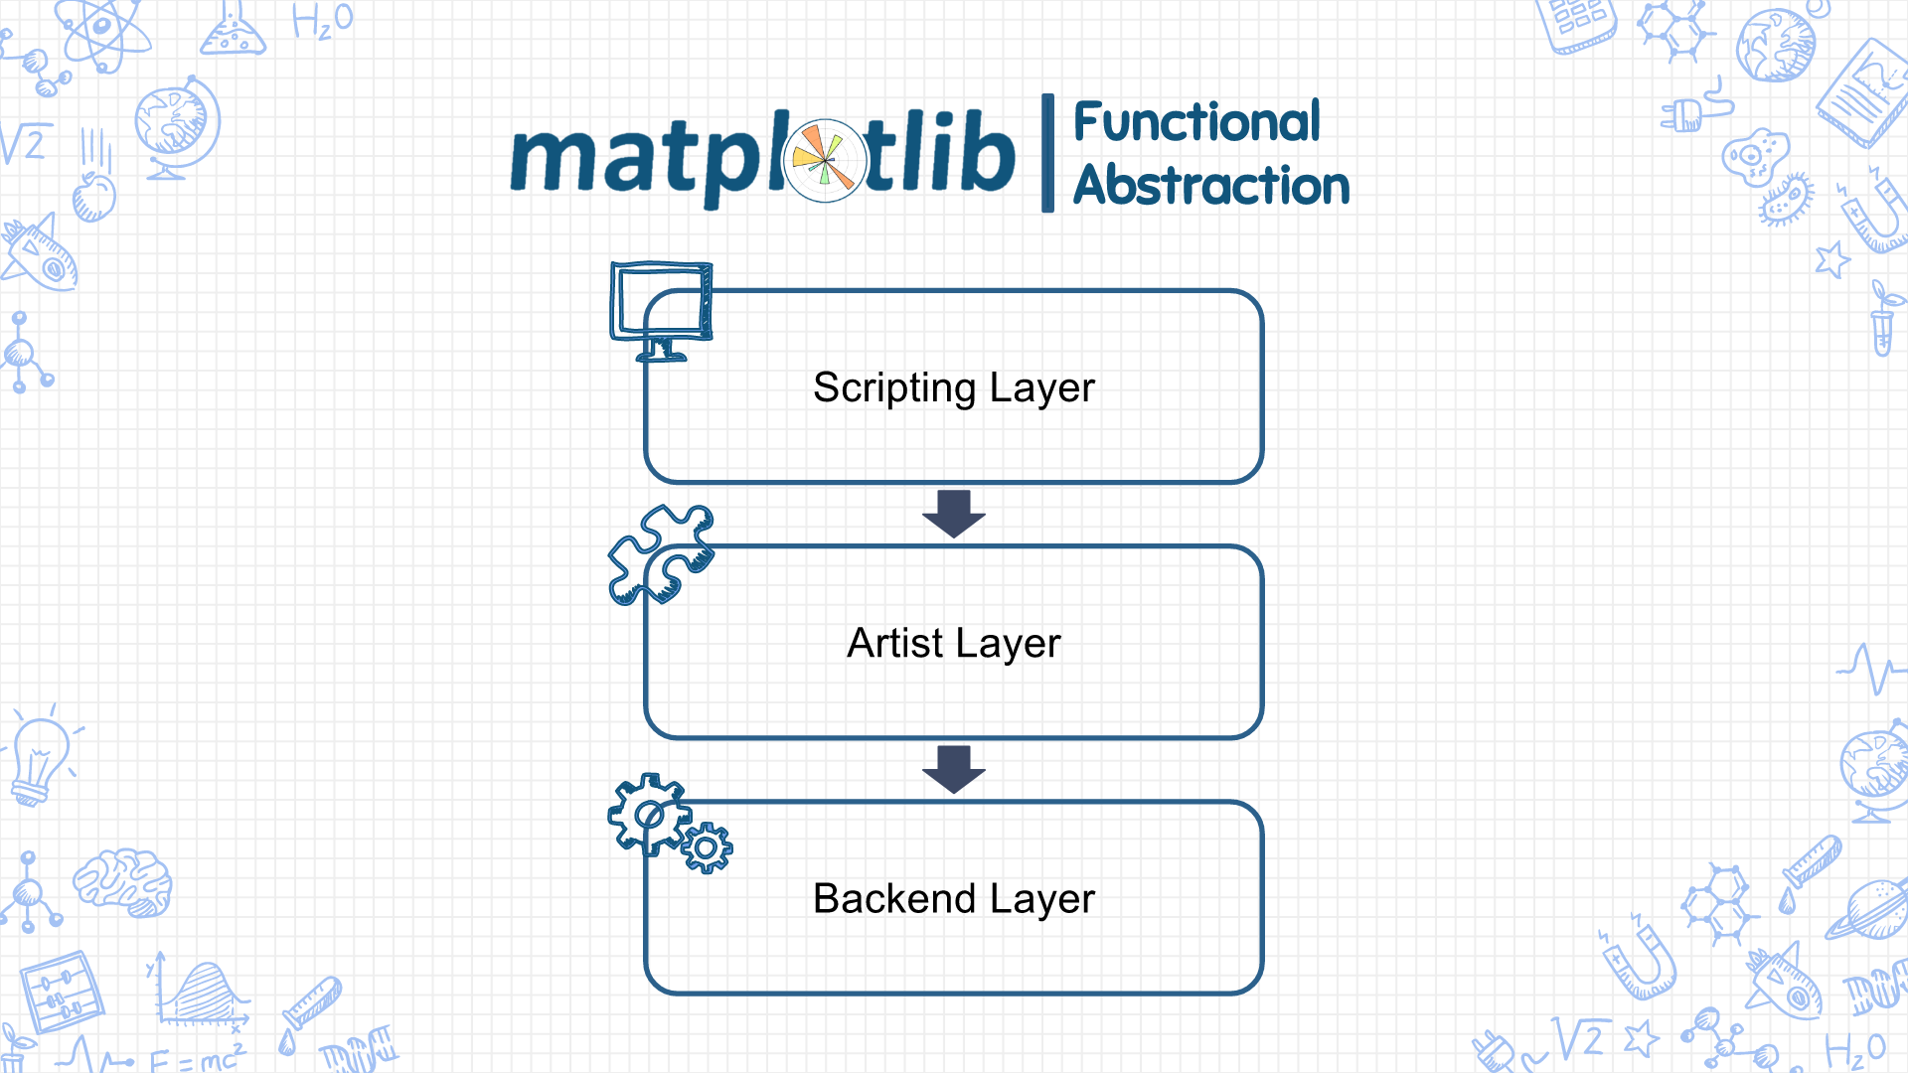
Matplotlib Architecture
(pyplot)
(Artist)
(Figure Canvas, Rendered, Event)

Slide 18
Matplotlib Architecture: Backend
Includes three abstract classes:
Figure Canvas (matplotlib.backend_bases.FigureCanvasBase): The canvas the figure renders into.
Renderer (matplotlib.backend_bases.RendererBase): An abstract base class to handle drawing/rendering operations. Responsible to draw in the FigureCanvas.
Event (matplotlib.backend_bases.Event): Handles user inputs such as keyboard and mouse clicks.

Slide 19
Matplotlib Architecture: Artist
It is composed of a single object type called Artist. Everything we see on a Matplotlib figure is an artist instance
Artist object uses the Renderer to draw on the canvas. It allows you to do more customization compare to the Scripting layer and is more convenient for advanced plots.
There are two types of artist objects:
Primitive Types: 2D Line, Rectangle, Circle and Text
Composite Type: Axis, Tick, Axes and Figure
A composite artist object may contain other primitive and/or composite artist objects

Slide 20
Matplotlib Architecture: Scripting Layer
The most important element in the scripting layer is the pyplot interface.
There is another interface called pylab which includes NumPy like capabilities alongside of figure creation but the use of pylab is discouraged by the Matplotlib developers
pyplot interface automates and hides the details of figure canvas & artist creation and connecting them together
Results in shorter codes for figure creation

Slide 21
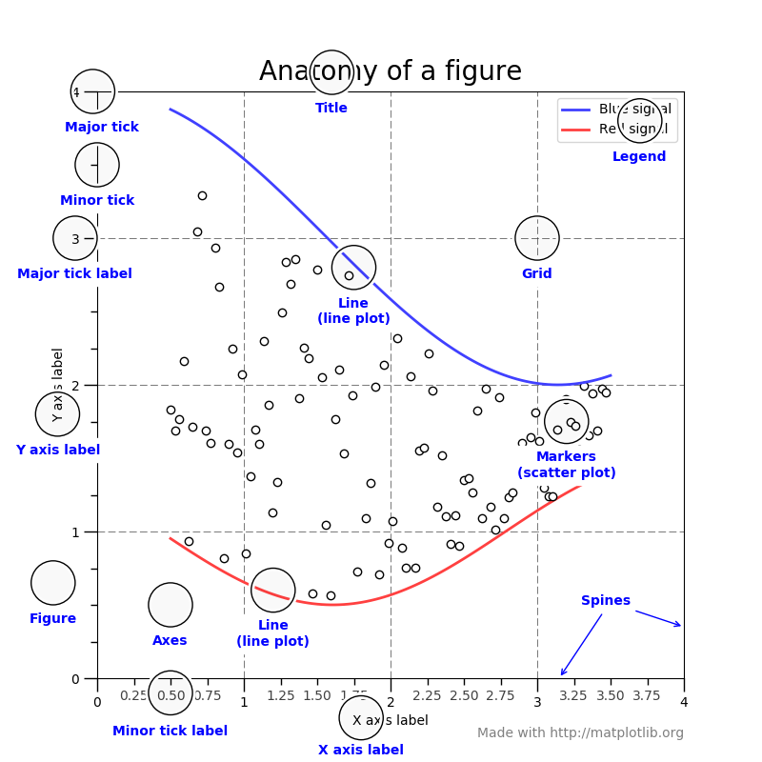
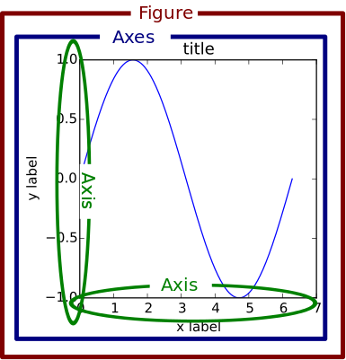
Anatomy of A Figure

Slide 22
Matplotlib – Pandas Relation
Pandas come with its own scripting interface for Matplotlib.
It can be used by calling dataframe.plot() function. The figure can be customized by using following parameters:
kind : “line”,“bar”,”barh”,”pie”,”scatter”etc…
color — Which accepts and array of hex codes corresponding sequential to each data series / column.
linestyle — ‘solid’, ‘dotted’, ‘dashed’ (applies to line graphs only)
xlim, ylim — specify a tuple (lower limit, upper limit) for which the plot will be drawn
legend— a boolean value to display or hide the legend
labels — a list corresponding to the number of columns in the dataframe, a descriptive name can be provided here for the legend
title — The string title of the plot

